Slide 1
Big Mountain Resort
Yasin Kusan

Slide 2
Problem Identification
Big Mountain Resort has recently installed an additional chair lift to help increase
distribution of visitors across the mountain. The chair increases operating costs by
$1.54 M. The current profit margin is 9.2%, and investors would like to keep it
there.

Slide 3
Recommendation and Key Findings
The price of adult weekend ticket prices should be increased from $81.00 to $86.05.
Assuming no drop in weekend attendance, this would represent an approximate 6% increase in revenue from adult weekend tickets.

Slide 4
Modeling Results and Analysis
A regression model was implemented in order to predict what the appropriate price of adult weekend tickets should be at Big Mountain Resort.
The data was cleaned before model implementation to fill null values, remove duplicates and perform outlier removal.

Slide 5
Modeling Results and Analysis
Explained Variance and Mean Absolute Error for the model are displayed below
An explained variance score of 1 is optimal
Mean absolute error should be as low as possible
Explained Variance | Mean Absolute Error
0.78 | 5.62

Slide 6
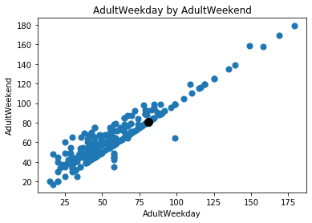
Modeling Results and Analysis
Support for increasing adult weekend price can be shown in figure 1. Figure 1 is a scatter plot of adult weekday ticket prices and adult weekend ticket prices for other ski resorts. For adult weekday prices<$100, it is common to have weekend prices that are $20-$40 higher.
Big Mountain Resort’s adult weekend ticket price is $81.00.
Figure 1

Slide 7
Summary and Conclusion
An increase of 6% in revenue in adult weekend ticket prices could protect the current 9.2% profit margin.. Afew considerations should be taken:
Increasing the ticket prices could result in fewer ticket sales.
Without additional data (projected weekend ticket sales, total projected profits) it is difficult to tell if the increased weekend ticket revenue will be sufficient.

